Slide 1
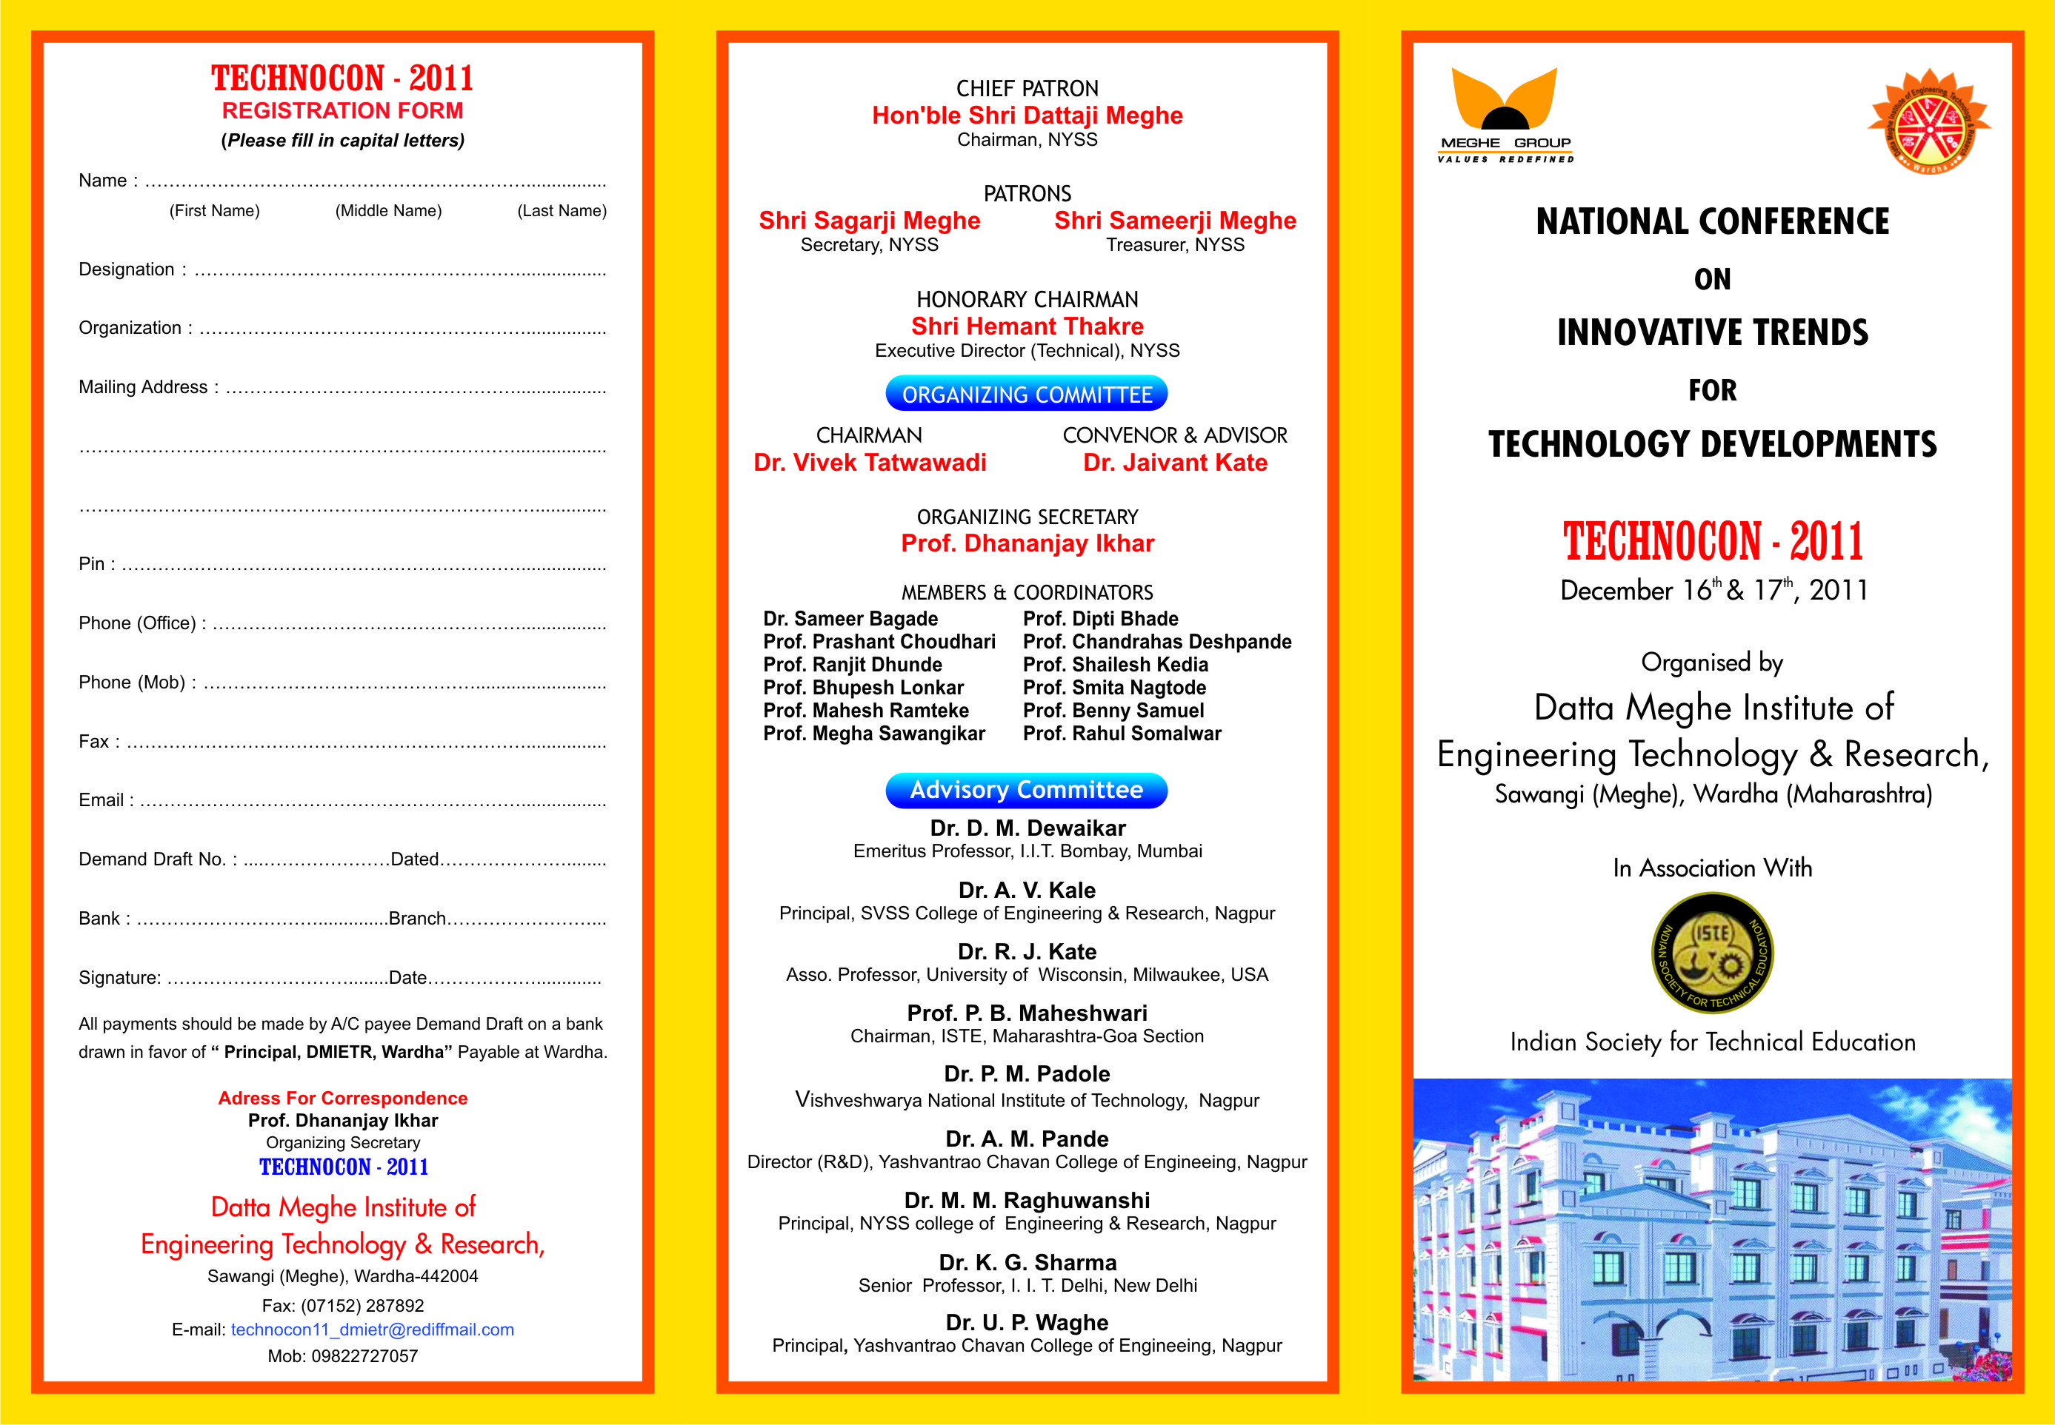
Datta Meghe Institute of Engineering, Technology & Research Sawangi (Meghe), Wardha.
A Seminar on “ Finding Similar Brand Drug in Other Parts Of Country”
Presented by
Mr. Shubham Jagtap Miss. Bhagyshree Babhulkar
Mr. Somesh Ghaturle Miss. Devyani Burande
Mr. Anurag Wankhede Miss. Ankita Mungal
Guided by
Prof. Gajanan Tikhe
Department of Computer science and Engineering 2017-18

Slide 2
Contents
Introduction
Problem Statement
Objective
Literature Survey
System Architecture
Module description
Proposed System Overview
Technology Stack
Conclusion
Reference

Slide 3
Introduction
Currently we are Working for Building an Application Which work for Alternative medicine on the Different sates
we need a Software Which Find the Exact same Content Medicine Over State or Region Wise

Slide 4
Problem statement
Doctors during their practice write brand drugs, which are available in only in specific location and these medicines can’t be purchased from any other geographical area because they are not been sold uniformly across all places.

Slide 5
Objective
Finds the brand drug in different regions (States).
Matches the alternative drug consistently.
Search the near by region for the availability of required drug through the Drug Name provided by the user.
Find the exact same content medicine with Dis-Similar name .

Slide 6
Literature survey
Use of generic medicines has been increasing in recent years, primarily as a cost saving measure in health care provision. There is existing 1MG application which provide the details for Medicine but, did not tell that in which reason this Medicine is going to available so , In our Application we are going to Overcome that Disadvantage to provide the Consistency to the User or Caretaker.

Slide 7
System architecture

Slide 8
Module Description

Slide 9
Proposed system overview
We are going to make application . Application will help the patient or caretaker to find the name of similar brand drug in that geographical area. The app will fetch the drug information from the HealthOS API. The Health OS API Data Platform provides next generation health care applications with a complete and unified database that includes medicines, generics, etc. It provides the alternative as well as similar brand drug & also the manufacturer details. Now here we made on assumption i.e. the pharmaceutical company will distribute its medicine according to the region of manufacturing.
Here a secondary database comes into play which is going to store the manufacturer's company locations. Finally, by mapping both databases that are HealthOS API database & secondary database on basis of manufacturer location and user location selected by the user ,User get the desired result.

Slide 10
Technology Stack Here
Mobile Application
Front End: HTML ,Ionic Framework , SACSS , Angular-JS , Apache Cordova(Compiler)
Back End: Google Fire Base Cloud Database & Health OSAPI

Slide 11
Conclusion
This application will help the patient as well as caretaker to find the medicine in the different type of country easily. To reduce the risk of duplication of brand drug provided by medicine store.

Slide 12
References
Ionic Framework Documentation
Google Firebase (Authentication and Documentation )
Health OS API

